Slide 1
BOOK LIBRARY SYSTEM

Slide 2
PRESENTATION OUTLINE
Abstract
Existing System
Proposed System
Advantages and Disadvantages
Hardware and Software Requirements
Modules
Module Description
Sample Output
Conclusion

Slide 3
ABSTRACT
The Book Library System is a full stack web application developed using HTML, CSS, JavaScript, Node.js and MongoDB. It allows users to manage library books efficiently by performing operations such as adding, viewing, borrowing, and returning books. The system maintains real-time updates in the MongoDB database whenever a book’s status changes. The backend ensures secure data handling, while the frontend provides a simple and interactive user interface. This project demonstrates how full stack development can automate library management tasks, improve accuracy, and reduce manual work. It also highlights the integration of client-side and server-side technologies in modern web development.

Slide 4
EXISTING SYSTEM
In the existing library management process, most operations are handled manually using registers or basic spreadsheets. Librarians record book details, borrowing dates, and return information by hand, which is time-consuming and prone to human error. Tracking the availability of books and managing large volumes of data becomes difficult as the number of users and books increases. There is also no centralized system for real-time updates, making it hard to maintain accurate records or prevent duplicate entries. As a result, manual systems lack efficiency, accuracy, and scalability for modern library management needs.

Slide 5
PROPOSED SYSTEM
The proposed system introduces a Book Library Management System developed using JavaScript Full Stack (HTML, CSS, Node.js and MongoDB) to automate and digitize library operations. This system allows users to add, borrow, return, and delete books through an interactive web interface, while all data is stored securely in the MongoDB database. It provides real-time updates on book availability and eliminates manual record-keeping errors. The system ensures faster processing, improved accuracy, and easy scalability, offering a centralized platform for efficient and modern library management.

Slide 6
ADVANTAGES AND DISADVANTAGES
ADVANTAGES:
Automation:Reduces manual work by automating book records and transactions.
Real-time Updates: Instantly reflects changes like book borrowing or returning in the database.
DISADVANTAGES:
Internet Dependency: The system requires an active internet connection to access the database.
Initial Setup Cost: Setting up servers and databases requires some technical knowledge and setup time.

Slide 7
HARDWARE REQUIREMENTS
Hardware Requirements:
Processor: Intel Core i3 or above
RAM: Minimum 4 GB (8 GB recommended)
Hard Disk: Minimum 250 GB storage
Monitor: Standard display with resolution 1024×768 or higher
Input Devices: Keyboard and Mouse

Slide 8
SOFTWARE REQUIREMENTS
Software Requirements:
Operating System: Windows / Linux / macOS
Editor: Visual Studio Code
Frontend: HTML, CSS, JavaScript
Backend: Node.js and Express.js
Database: MongoDB
Version Control: Git and GitHub
Browser: Google Chrome or any modern browser

Slide 9
MODULE
User Module
Book Management Module
Borrow/Return Module
Database Module
Admin Module

Slide 10
MODULE DESCRIPTION
The Book Library System consists of several integrated modules that work together to manage library operations efficiently. The User Module allows users to interact with the system through a web interface, enabling them to view available books, borrow, and return them easily. The Book Management Module is responsible for handling book records such as adding, updating, and deleting information including book titles, authors, and availability status. The Borrow and Return Module keeps track of issued and returned books, ensuring real-time updates in the database. The Database Module stores all book and transaction details securely in MongoDB and maintains synchronization with the user interface. Additionally, the Admin Module allows administrators to oversee library activities, manage records, and monitor the overall functioning of the system effectively.

Slide 11
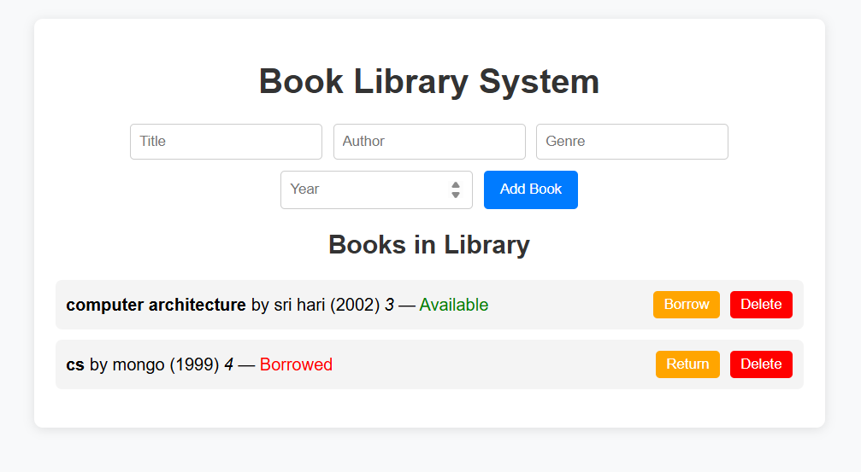
SAMPLE OUTPUT

Slide 12
CONCLUSION
The Book Library System successfully automates traditional library operations using modern web technologies such as HTML, CSS, JavaScript, Node.js, Express.js, and MongoDB. The system simplifies the process of managing books, borrowing, and returning records, providing real-time updates and accurate data storage. By integrating both frontend and backend technologies, it ensures smooth communication between users and the database. This project reduces manual effort, minimizes errors, and enhances the overall efficiency of library management. Thus, the developed system proves to be a reliable, scalable, and user-friendly solution for digital library management in educational and institutional environments.

Slide 13


